Slide 1
Cashier algorithm with Turkish currency implementation
224308902 Nurbek Juraev
214308917 Abdulmajid idris
200201806 Ertuğrul Gürler
190200041 FEYZA SARIOĞLU
190201033 Bircan AYGÜN
180201071 Emre Dalgıç
190201039 Zehra Nur MANGAL
180201011 Ayşe Beyza Doğan
Team members and IDs

Slide 2
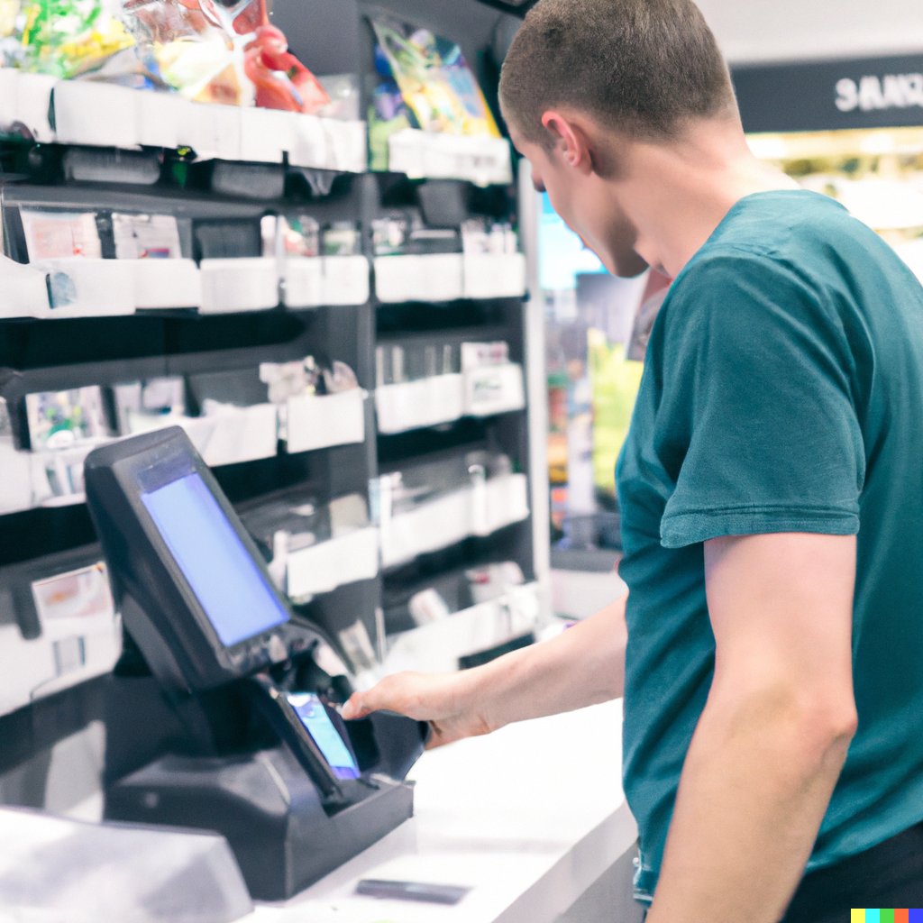
About our algorithm
Our algorithm is used to find the minimum number of denominations of Turkish currency needed to make a given amount of money.
Our algorithm is based on greedy algorithm, is one that always takes the best immediate, or local, solution while finding an answer. Greedy algorithms find the overall, or globally, optimal solution for some optimization problems, but may find less-than-optimal solutions for some instances of other problems.
However, we have modified our algorithm to make it an optimal solution provider for our problem.

Slide 3
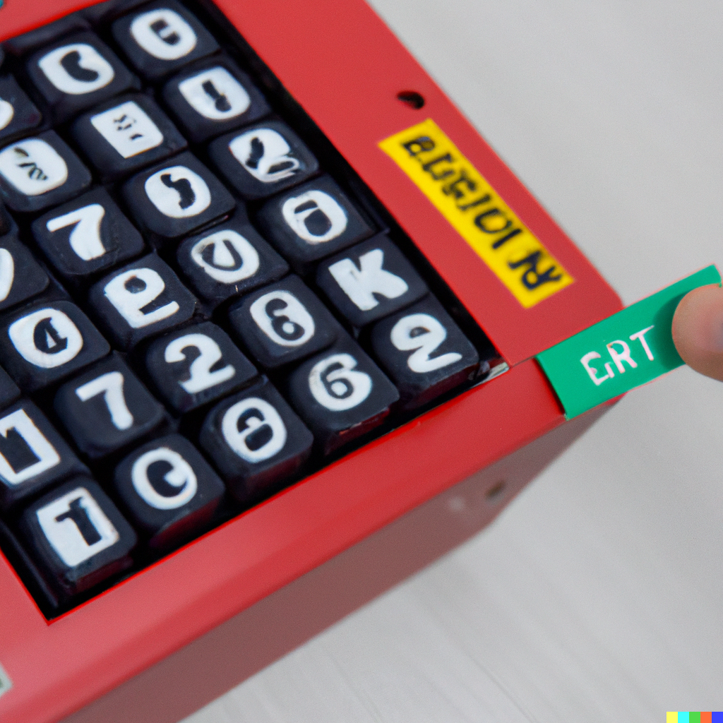
Input of our algorithm
The input for this algorithm includes the variable V, which is the value to be expressed in terms of the available denominations of Turkish currency, and the limits list, which is a list of the maximum number of each denomination that can be used. V is initialized to the value 150.52*100, which means the value to be expressed is 150.52 Turkish lira. The limits list is initialized to a list of integers representing the maximum number of each denomination that can be used.

Slide 4
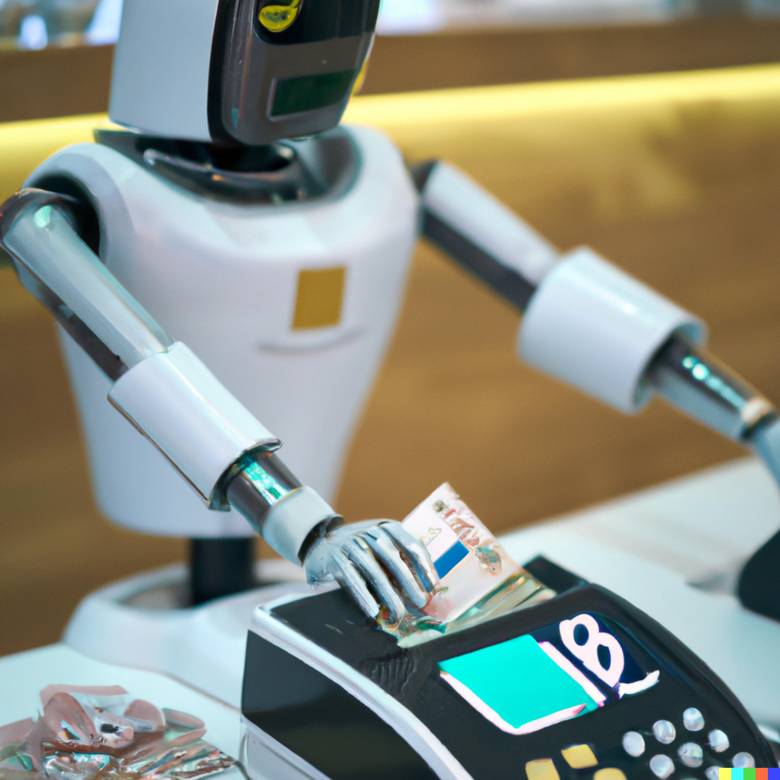
Output of our algorithm
The output of this algorithm will be a list of the denominations of Turkish currency needed to express the value V in the most minimal way possible, given the maximum number of each denomination specified in the limits list. The output will be printed to the console, with each denomination separated by a space.
For example, if V is initialized to 150.52*100 and limits is initialized to [10, 5, 10, 5, 10, 5, 10, 5, 1, 1, 5, 5], the output might be: "100 50 0.5 0.01 0.01". This means that the value of 150.52 Turkish lira can be expressed using 1-100 lira 1-50 lira 1-50 kurus 2-1 kurus denominations, given the specified limits on the number of each denomination that can be used.

Slide 5
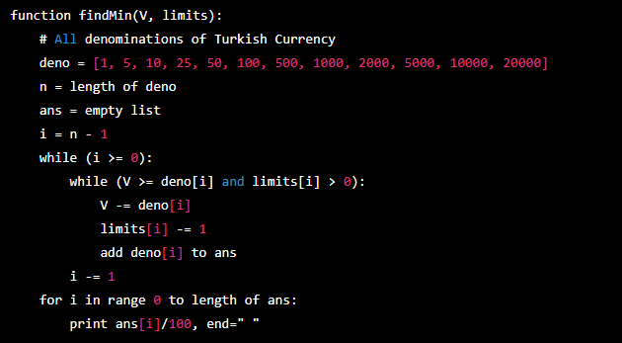
Pseudocode for the current algorithm
This pseudocode describes the overall structure and logic of the findMin function, which takes two inputs: V, the value to be expressed in terms of the available denominations of Turkish currency, and limits, a list of the maximum number of each denomination that can be used. The function first initializes a list of all the denominations of Turkish currency, and a list ans to store the denominations that will be used to express V. It then enters a loop that starts at the largest denomination and works its way down to the smallest, trying to use as many of each denomination as possible given the specified limits. The function then prints the list ans to the console, with each denomination separated by a space.

Slide 6

Running time of the current algorithm
The running time of the current algorithm is O(n), where n is the number of denominations of Turkish currency. This is because the algorithm performs a single pass through the list of denominations, and the number of operations performed within the loop is constant (i.e., the loop does not contain any nested loops or perform any operations that have a variable running time).

Slide 7
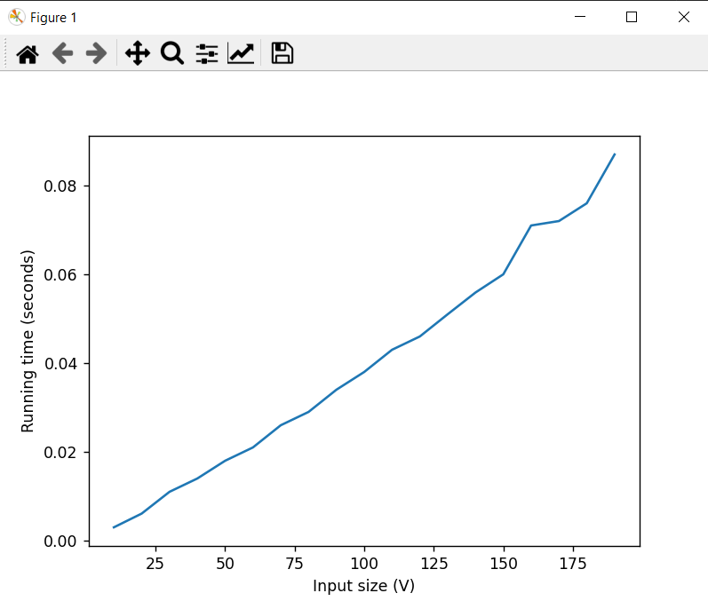
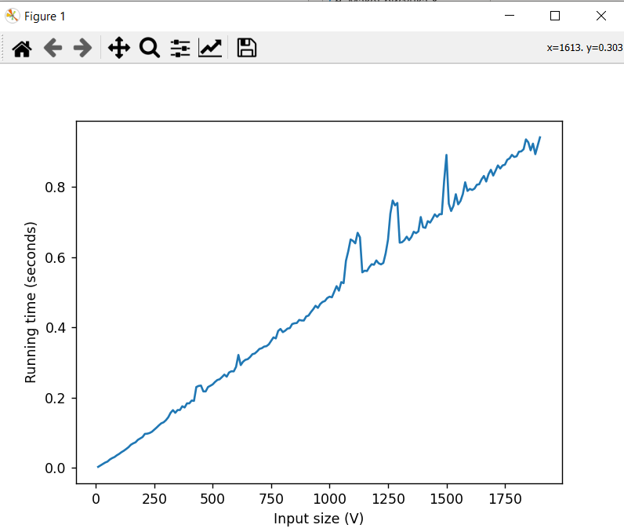
Comparing running time of the algorithm with various input sizes

Slide 8
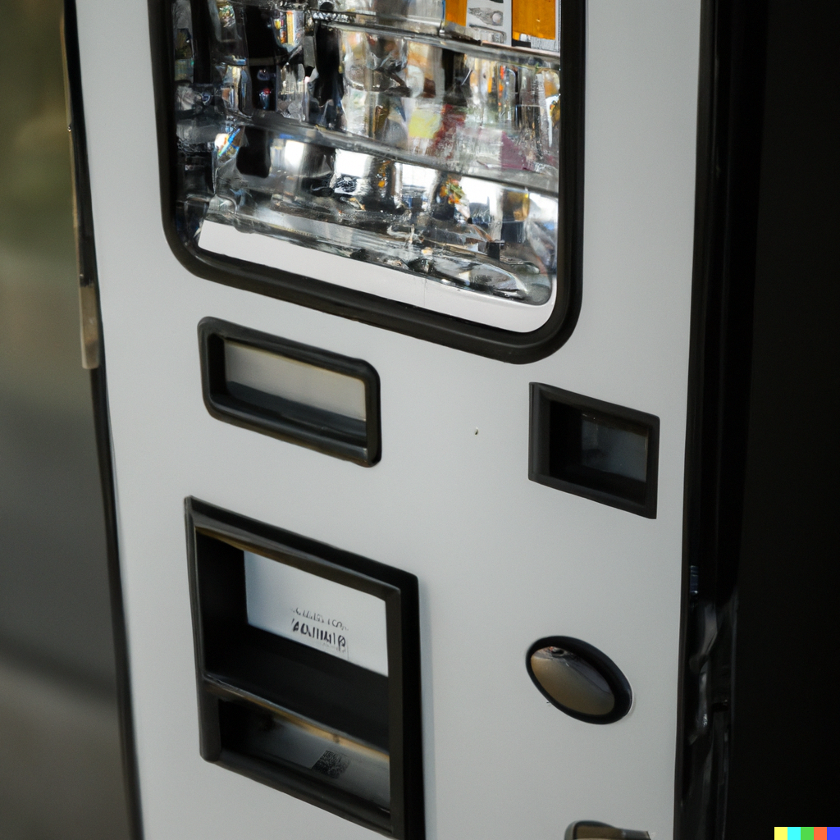
Real-world application of the algorithm
Vending machine that needs to dispense change to customers. In order to minimize the number of coins or bills it needs to dispense, the vending machine could use our algorithm to find the minimum number of denominations needed to express the amount of change owed.

Slide 9
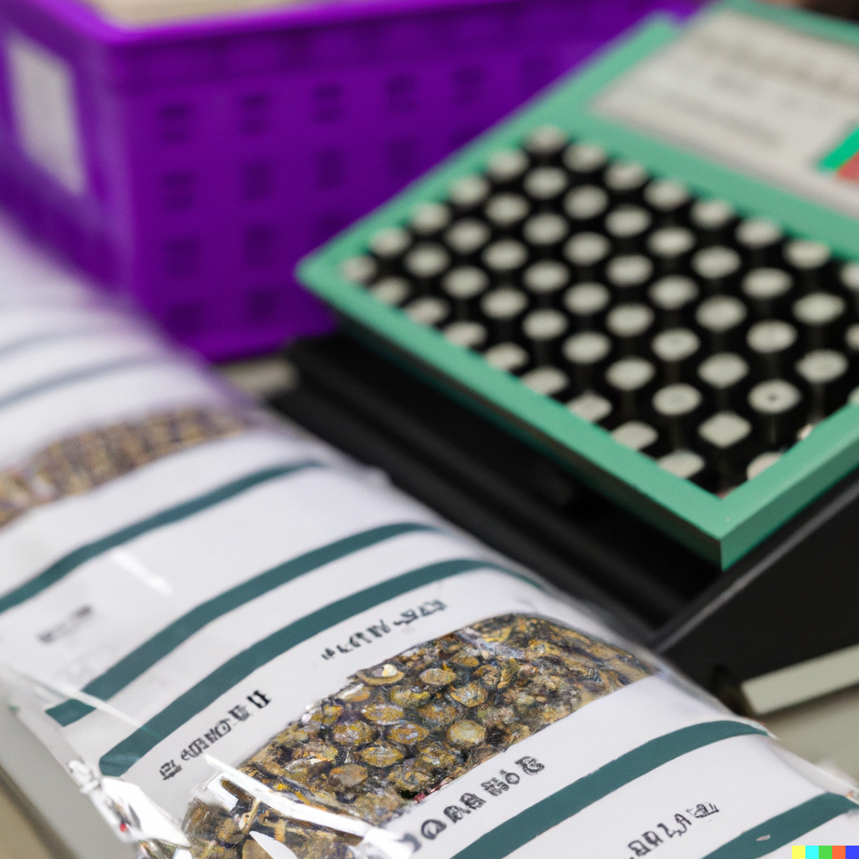
Real-world application of the algorithm
Software program used by a bank to count and package coins and bills for transport. This program could use our algorithm to minimize the number of packages needed to transport a given amount of money.
These are just a couple of examples, but our algorithm has many other potential applications in areas such as finance, computer science, and engineering.

Slide 10

Importance of our Algorithm
Our code is important because it helps to ensure the accuracy and efficiency of financial transactions in Turkish currency. By using this code, a cashier or financial institution can quickly and easily determine the minimum number of denominations needed to make a transaction, saving time and reducing the risk of errors. This is especially important in a country like Turkey where there is a high volume of financial transactions and a need for efficient and accurate exchanges.

Slide 11
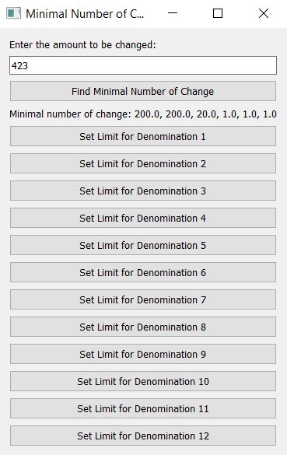
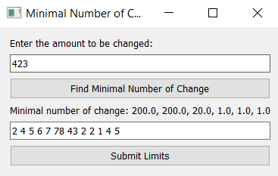
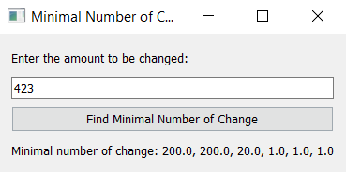
GUI for our Algorithm with 3 versions

Slide 12

The programming language used in our implementation
Python ver. 3

Slide 13
Thanks a lot for your attention.

